Slide 1
Azure Study Group AZ-300 - Microsoft Azure Architect Technologies
Shawn Weisfeld
Cloud Solution Architect

Slide 2
Week 4 Implement authentication and secure data (5-10%)

Slide 3
Agenda
Agenda
1
Speaker Introduction
2
Feedback Loop
3
Objective Review
4
Open Mic
5

Slide 4
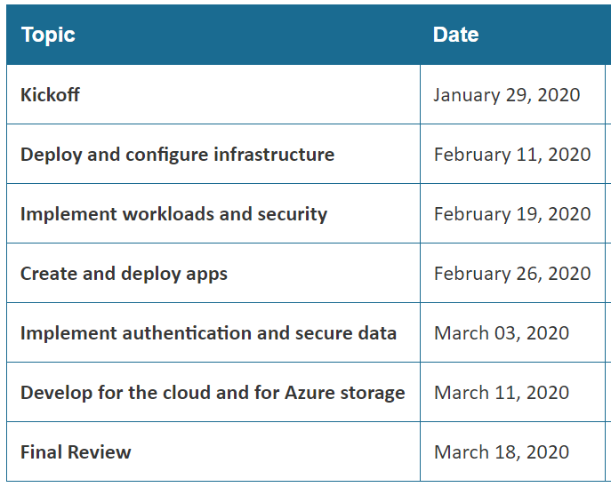
Series Agenda
Yammer: https://aka.ms/azurecsg
Homework:
https://aka.ms/AZ-300StudyGroup

Slide 5

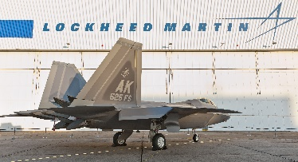




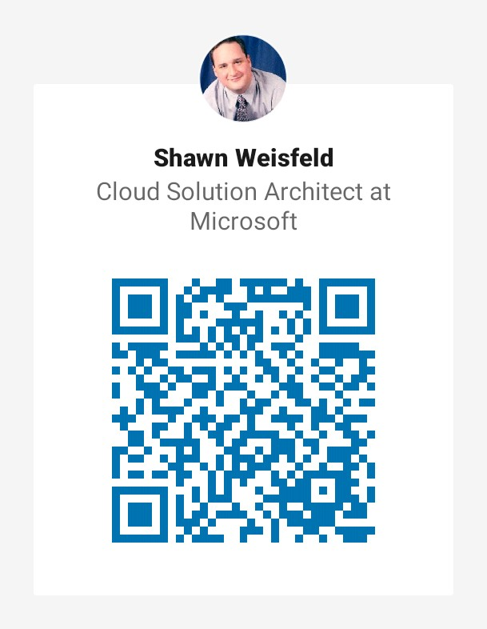













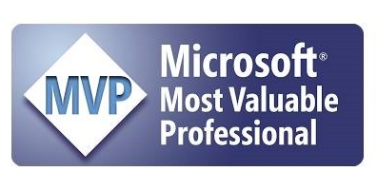




Slide 6
Feedback Loop

Slide 7
Implement authentication
implement authentication by using certificates, forms-based authentication, tokens, or Windows-integrated authentication
implement multi-factor authentication by using Azure AD
implement OAuth2 authentication
implement Managed Identities for Azure resources Service Principal authentication

Slide 8
Azure Active Directory
Self-service password reset
Azure Multi-Factor Authentication
Hybrid integration to write password changes back to on-premises environment
Hybrid integration to enforce password protection policies for an on-premises environment
Passwordless authentication

Slide 9
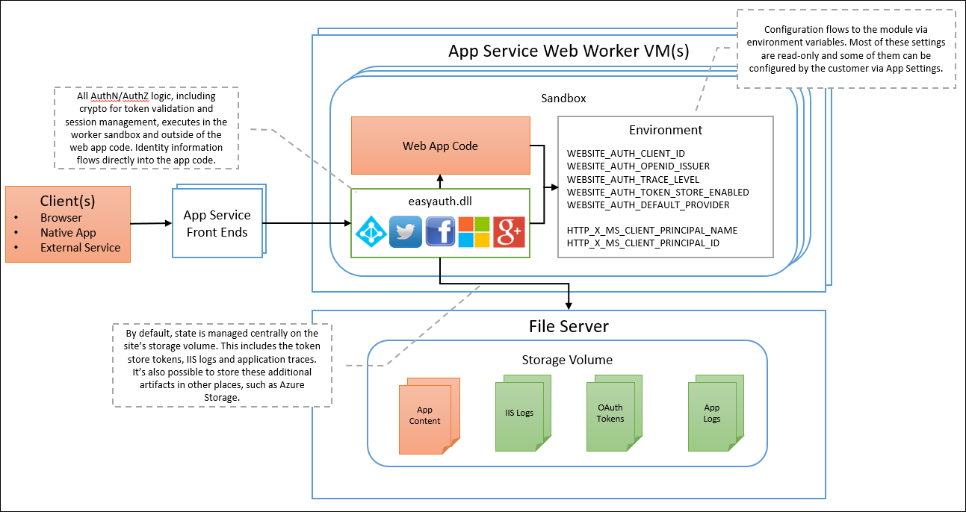
Auth in Azure App Service

Slide 10
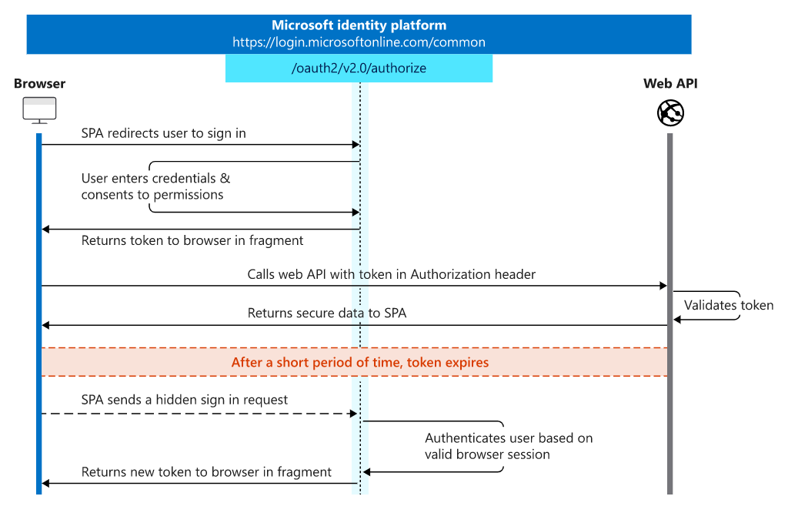
Implement OAuth2 - Single-page apps (JavaScript)

Slide 11
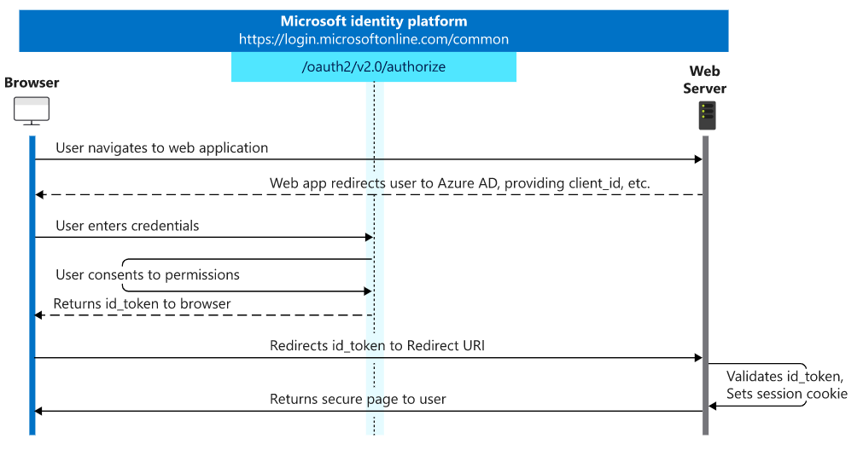
Implement OAuth2 - Web apps

Slide 12
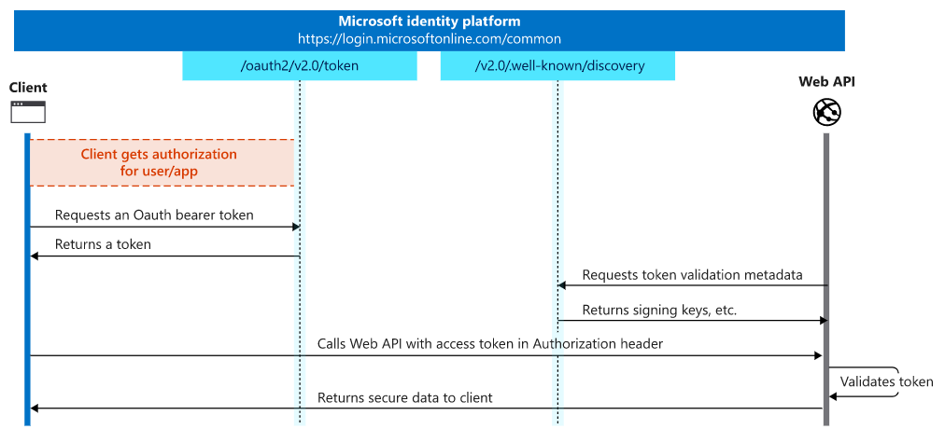
Implement OAuth2 - Web APIs

Slide 13
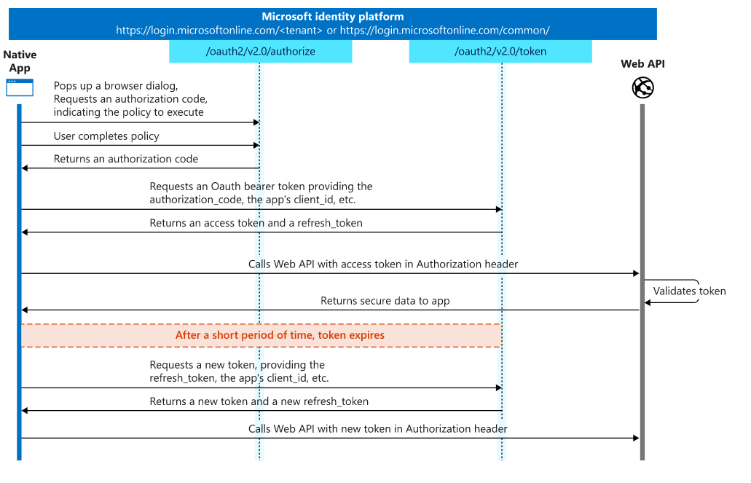
Implement OAuth2 - Mobile and native apps

Slide 14
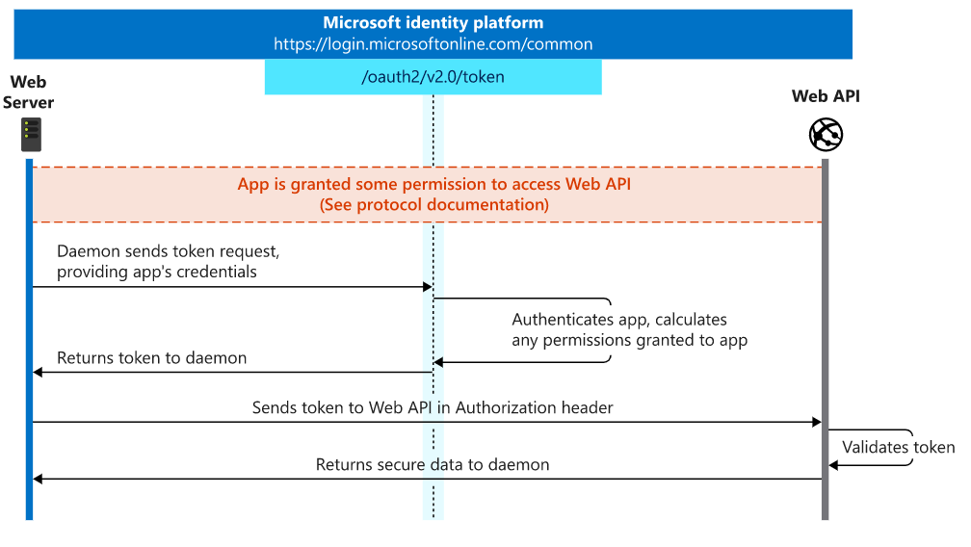
Implement OAuth2 - Daemons and server-side apps

Slide 15
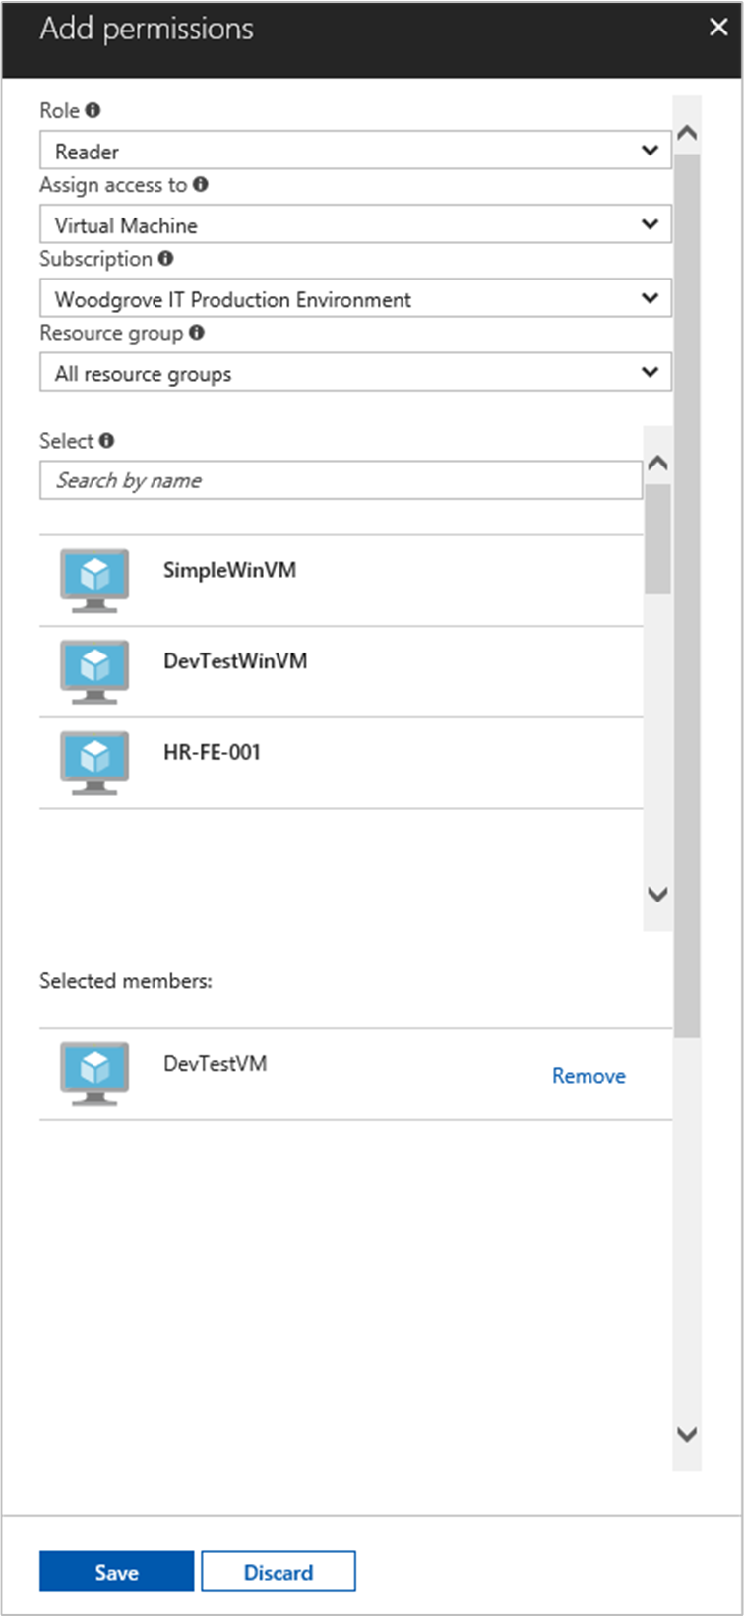
Managed Identities
Give code running in a VM the ability to auth without a password
Add Permissions to your instance
Auth endpoint
http://169.254.169.254/metadata/identity/oauth2/token
Not supported by every Azure service

Slide 16
Implement secure data solutions
encrypt and decrypt data at rest and in transit
encrypt data with Always Encrypted
implement Azure Confidential Compute
implement SSL/TLS communications
create, read, update, and delete keys, secrets, and certificates by using the KeyVault API

Slide 17
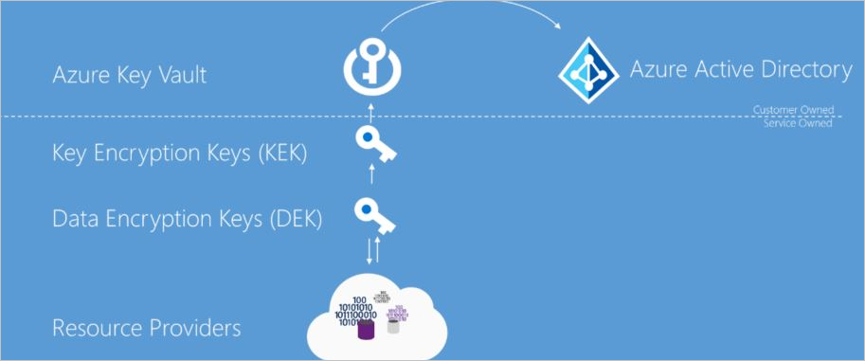
Azure Data Encryption-at-Rest
A symmetric encryption key is used to encrypt data as it is written to storage.
The same encryption key is used to decrypt that data as it is readied for use in memory.

Slide 18
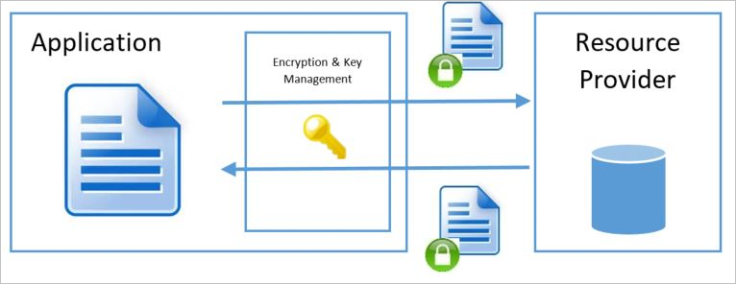
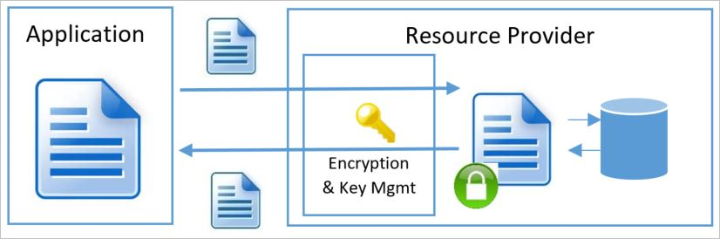
Client vs. Server Site Encryption
Client Side
Server Side

Slide 19
Azure Data Encryption-in-Transit
Typically TLS
But different services support different protocols

Slide 20
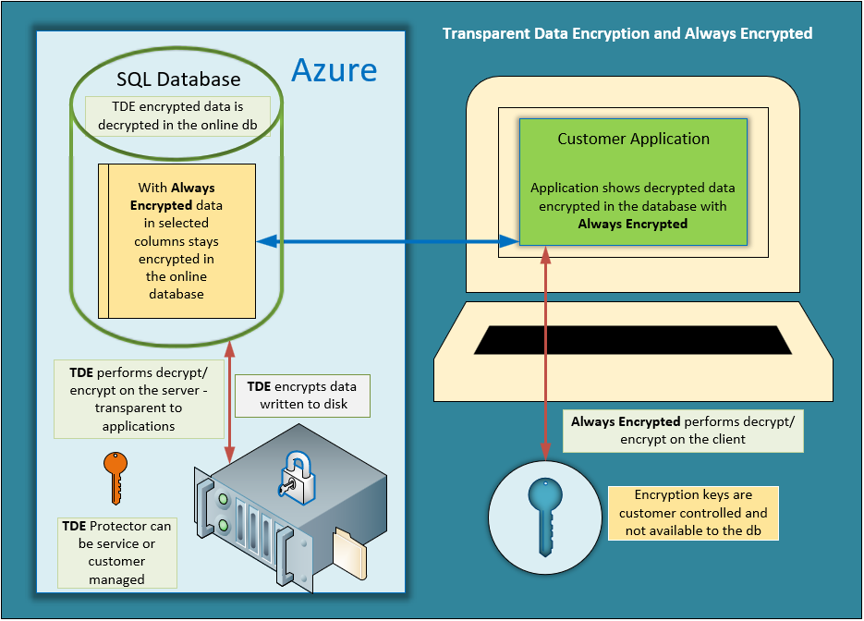
SQL Server: TDE vs Always Encrypted

Slide 21
Azure confidential computing
Encryption in use
Trusted Execution Environments (TEEs) - black box where code can use data that is hidden from the machine, cloud provider, etc.
Implemented by hardware or the hypervisor
Intel SGX enabled VMs available in Azure
App SDKs that can interact with TEEs
Why?
Keep sensitive data secret
Multi-party processing over shared data preventing each from seeing the other data

Slide 22
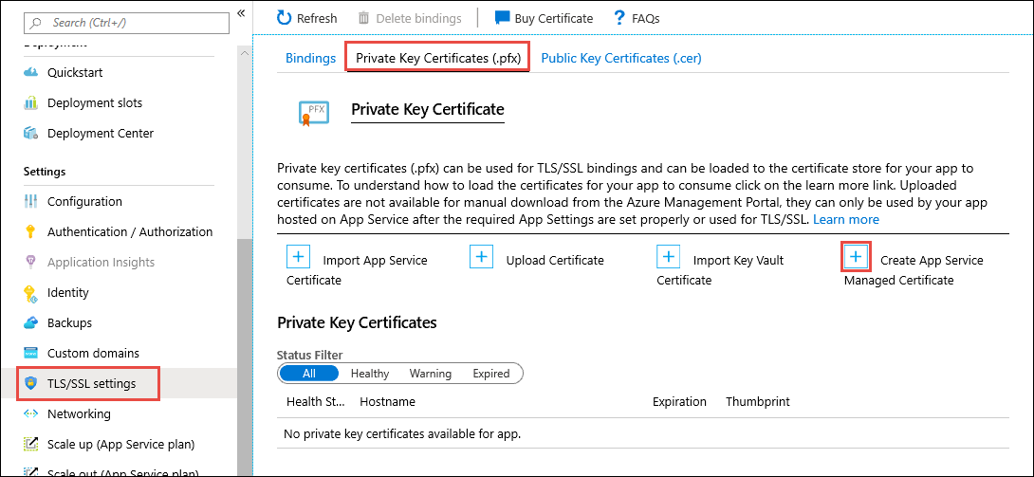
SSL in Azure App Service

Slide 23
Azure Key Vault
Secrets Management
Key Management
Certificate Management
Backed by Hardware Security Modules or in software
Centralize application secrets
Monitor access and use
Integrated with other Azure services
Secured by AAD
Versioned

Slide 24
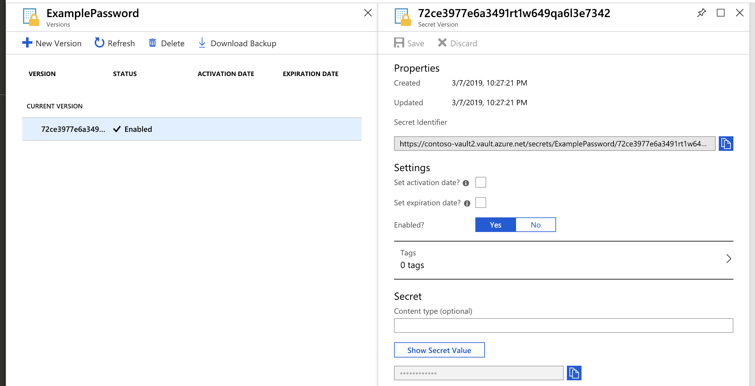
Secret in Azure Key Vault

Slide 25


Questions?

Slide 26
Homework Assignment
https://aka.ms/AZ-300StudyGroup

Slide 27

Open Mic …

